Slide 1
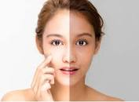
Tyrosinase inhibitors
Dr.P.PREETHI

Slide 2
Melanin
is a pigment that is synthesized by melanocyte cells deep in the dermis
synthesis takes place within melanosomes in melanocyte cells with the help of tyrosinase enzyme to protect skin against UV damage
Melanosomes synthesize, store, and transport melanin pigment to the upper layers of the skin

Slide 3
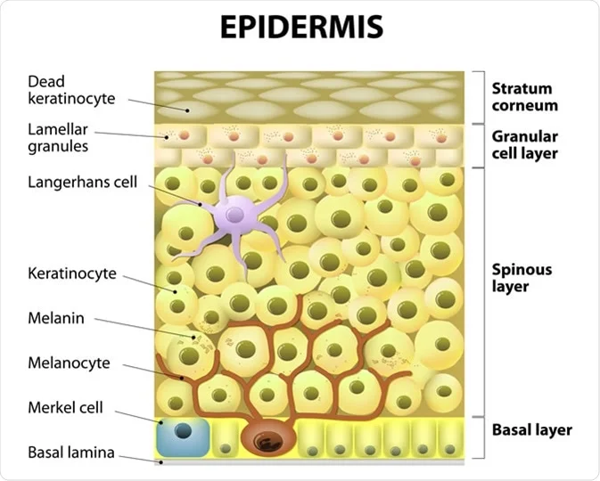

Slide 4
TYROSINASE
Is monophenol or o-diphenol
is oxygen oxidoreductase
also called as polyphenol oxidase
Is a multifunctional,membrane bound,type-3 copper-containing glycoprotein is located in the membrane of the melanosome
tyrosinase is a key enzyme, which catalyzes a rate-limiting step of the melanin synthesis
downregulation of tyrosinase is the most prominent approach for the development of melanogenesis inhibitors.
frequency and amount at which melanocytes produce melanin is determined by the enzyme tyrosinase

Slide 5
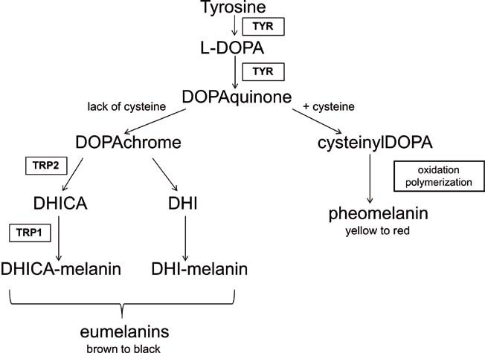
MELANOGENESIS

Slide 6
TYROSINASE INHIBITOR
Most of cosmetics or skin lightening agents are tyrosinase inhibitors.
The fact that the inhibitors target tyrosinase may specifically inhibit the melanogenesis in cells with few side effects, as tyrosinase is exclusively produced only by melanocytes.
Eg: hydroquinone
arbutin
kojic acid
azelaic acid
L-ascorbic acid
ellagic acid
tranexamic acid

Slide 7
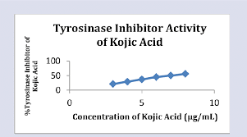
Kojic acid
is a skin lightening agent used extensively in skin lightening skin care products
It penetrates deep within skin layers and inhibits tyrosinase activity to reduce melanin production

Slide 8
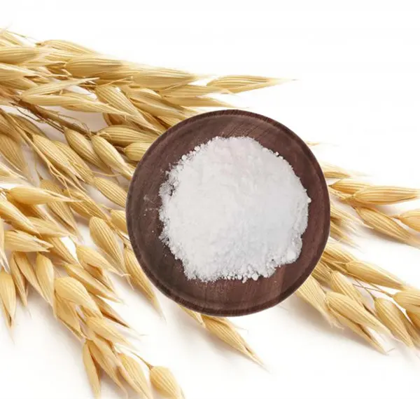
Ferulic Acid
is an antioxidant that binds directly to the tyrosinase enzyme, inhibiting its activity, and slowing down the production of melanin.
It also smoothes out fine lines and wrinkles too.

Slide 9
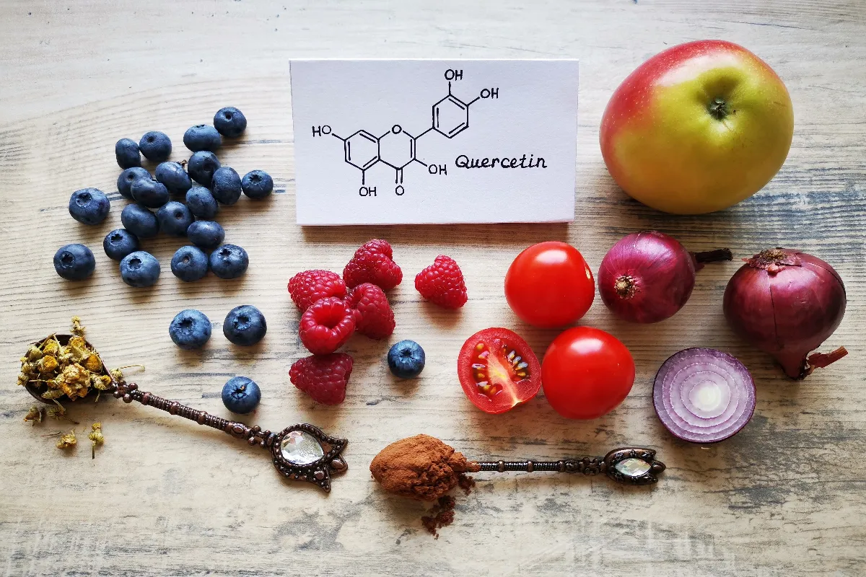
Quercetin
is also an antioxidant, a flavonoid compound
which inhibits monophenolase and diphenolase activities of tyrosinase enzyme
A lot of citrus fruits, grapes, berries, apples, honey are rich sources

Slide 10
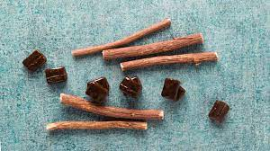
Licorice extract
Also called as Glycyrrhiza glabra
is actually the herbal root of the Glycyrrhiza plant and is used extensively used in skin-lightening products and helps to brighten up skin
It also has anti-microbial properties.

Slide 11
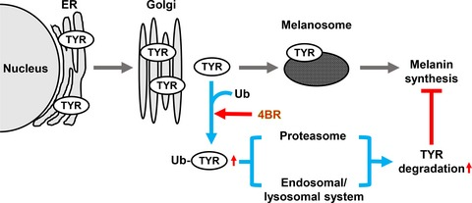
4‐n-butylresorcinol
is a strong tyrosinase inhibitor
is present in many skincare products to inhibit melanin production

Slide 12
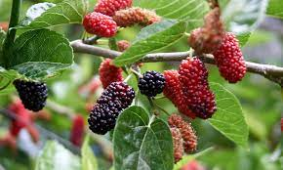
Mulberry extract
is natural ingredient is extracted from mulberry leaves have strong tyrosinase inhibiting activity
is probably the safest skin lightening agents

Slide 13
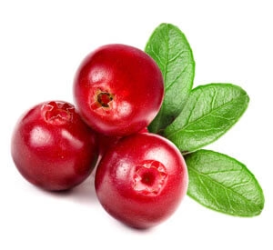
Alpha arbutin
Extracted through plant sources such as cranberries, bearberries
it’s considered to be a good anti-hyperpigmentation agent
that helps to clear dark spots without irritating the skin.

Slide 14
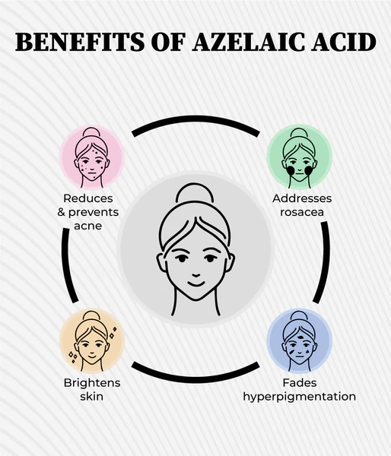
Azelaic Acid
is one of the naturally occurring ingredients that is produced by skin’s microbiome and can be obtained from barley, wheat and other grains.
It belongs to the family of carboxylic acids.
It is considered to be a wonderful ingredient for acne-prone skin because of antibacterial and anti-inflammatory properties.
Also, it helps in exfoliating the skin as well.
You can find azelaic acid in prescribed medicines and some over-the-counter and cosmetic products.
Azelaic acid can be used to treat hyperpigmentation and melasma.
This acid is known to target the pigment-producing cells-hyperactive melanocytes.
This makes it perfect for treating dark spots and hyperpigmentation, making the skin even-toned. Moreover, it exfoliates the skin and sloughs off the dead skin cells, revealing a smoother skin.

Slide 15
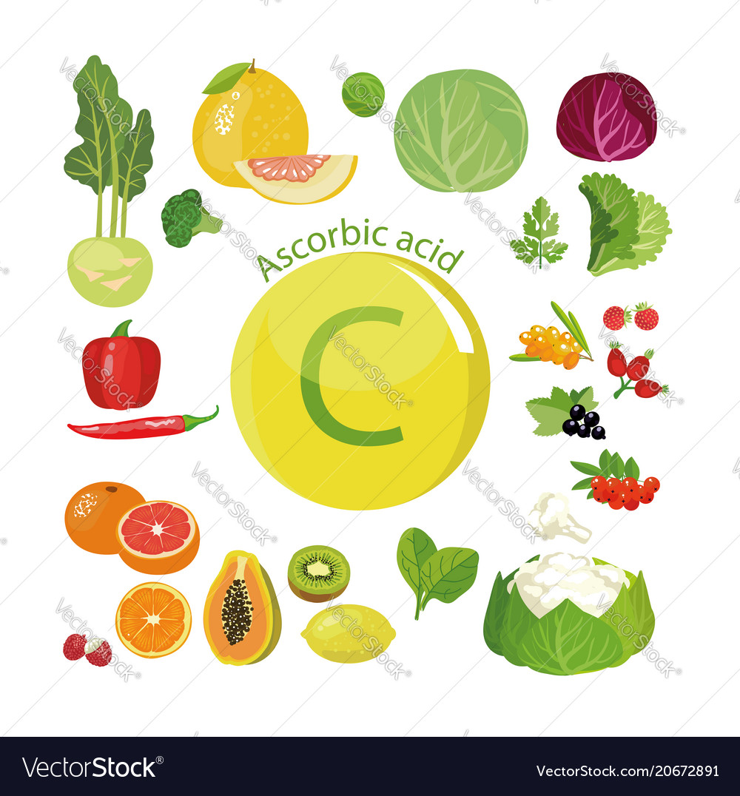
L-ascorbic Acid
is the topmost skin brightening and lightening agent that inhibits tyrosinase enzyme and reduces melanin production at the cellular level
It is widely used in serums to reduce and treat hyperpigmentation
Vitamin C is the topmost skin brightening and lightening agent that inhibits tyrosinase enzyme and reduces melanin production at the cellular level
It is widely used in serums to reduce and treat hyperpigmentation.

Slide 16
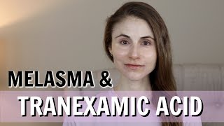
Tranexamic acid
is a lesser known skin-lightening agent
Tranexamic acid is used in ointments and skin creams for its effect on decreasing the activity of tyrosinase and melanogenesis.

Slide 17


